Slide 1
Capston project on the tableau.
Project topic :WORLD INDICATORS_MIGRATION DATA.

Slide 2
Problem statement
Most populated country .
Age group wise population in china.
Tourist outbound in 12 years.
Country-wise CO2 emission.
Relation between birth rate,mortality rate and gdp expenditure.
Most energy consuming country.
Country with GDP per capita.

Slide 3
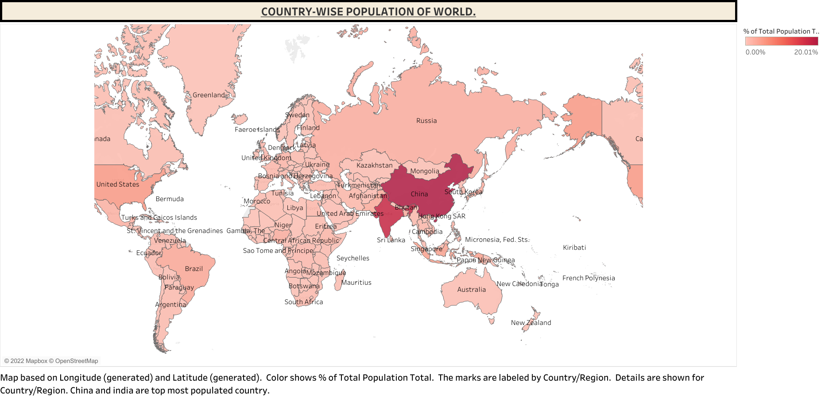

Slide 4
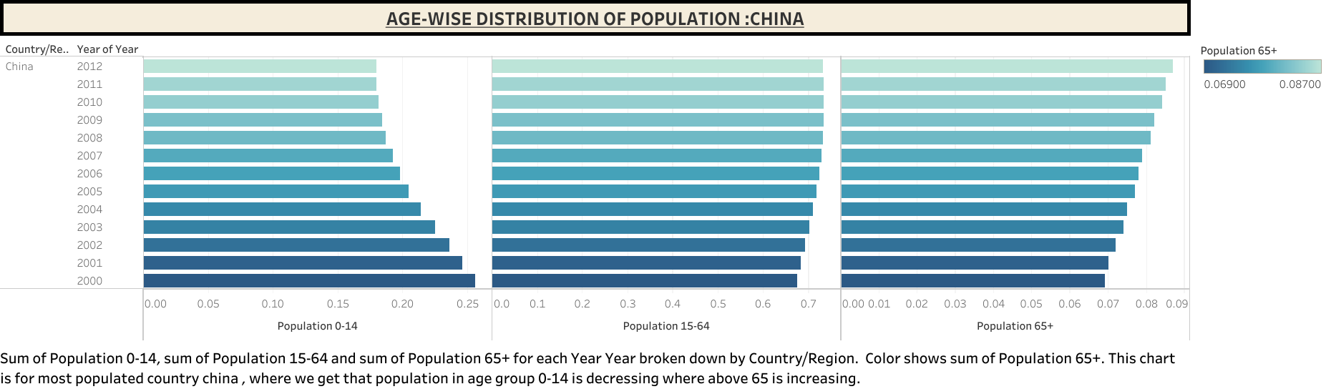

Slide 5
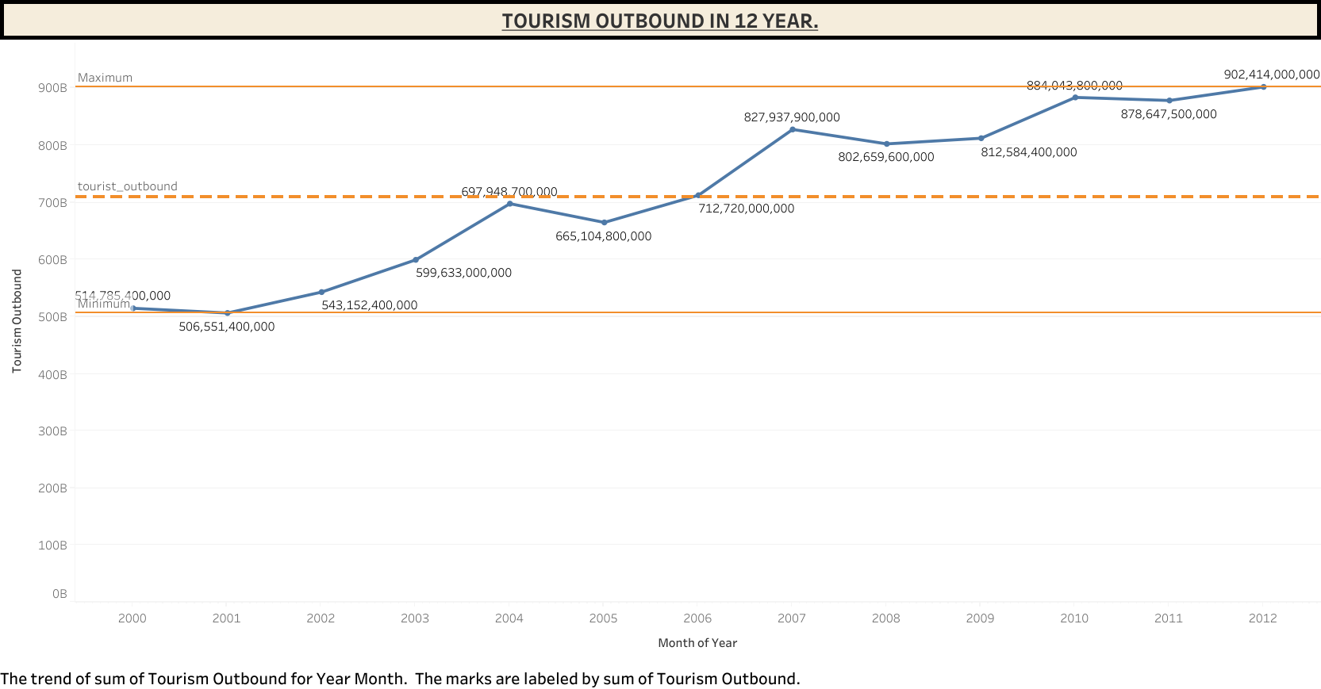

Slide 6
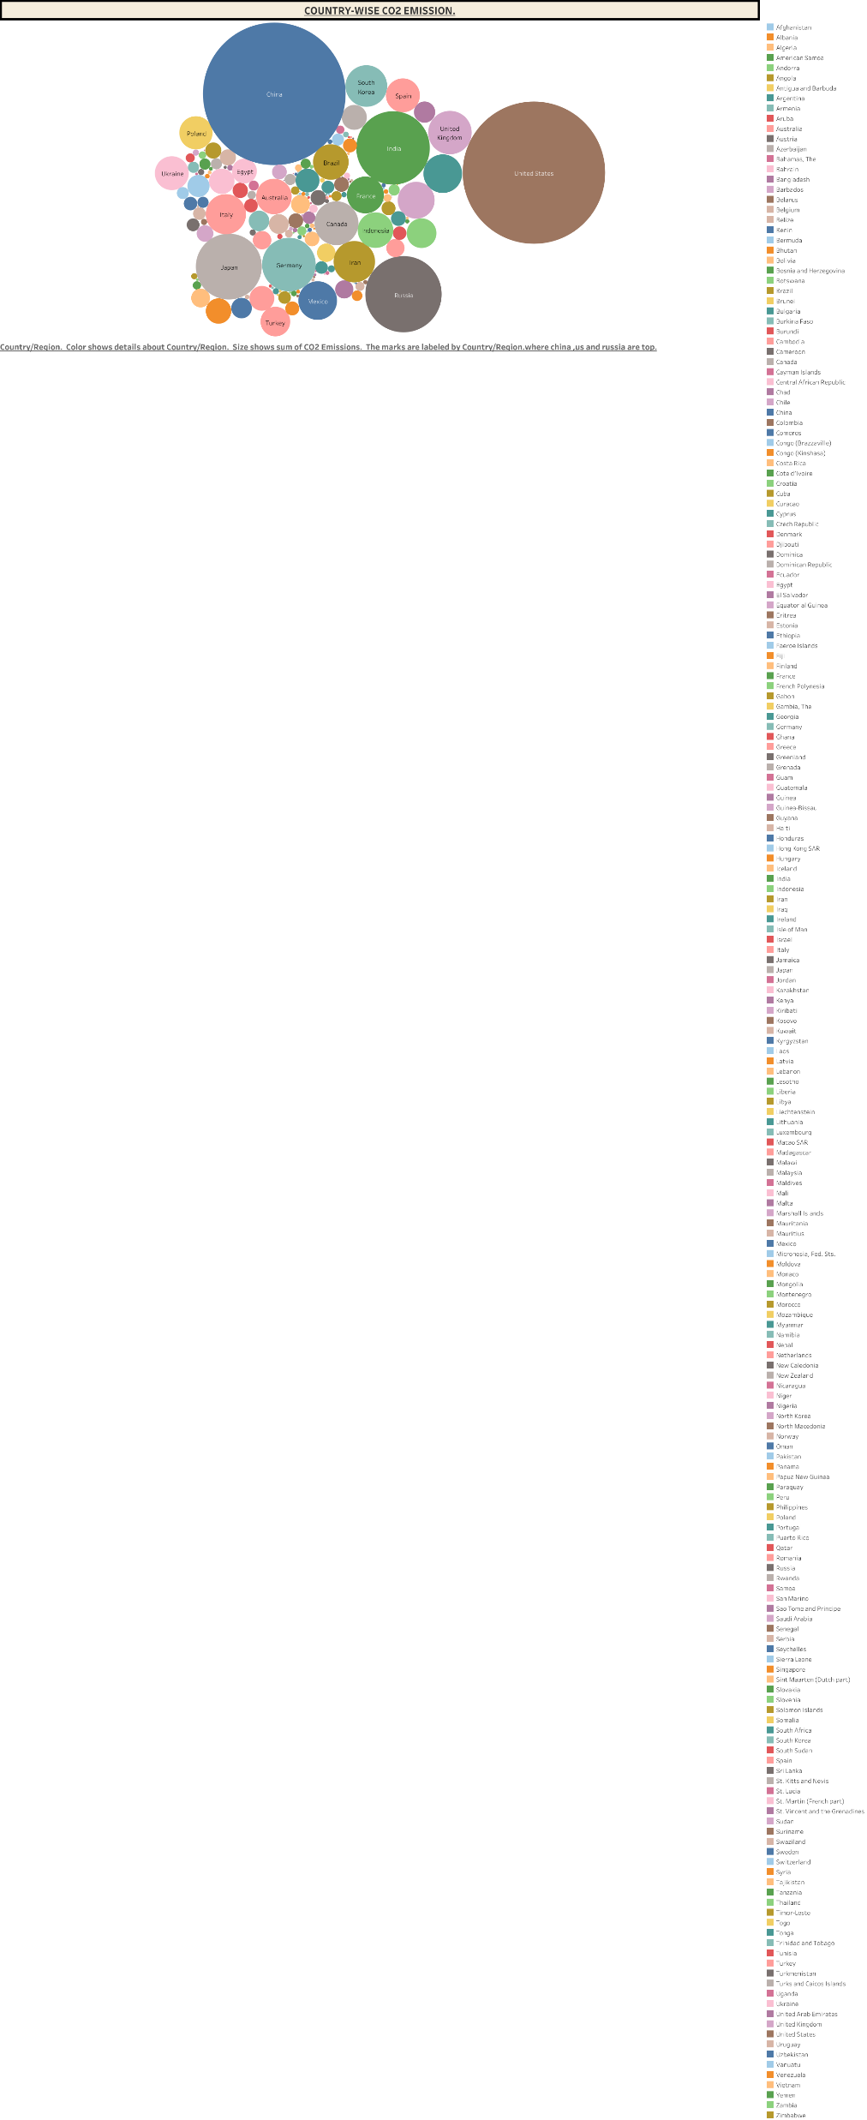

Slide 7
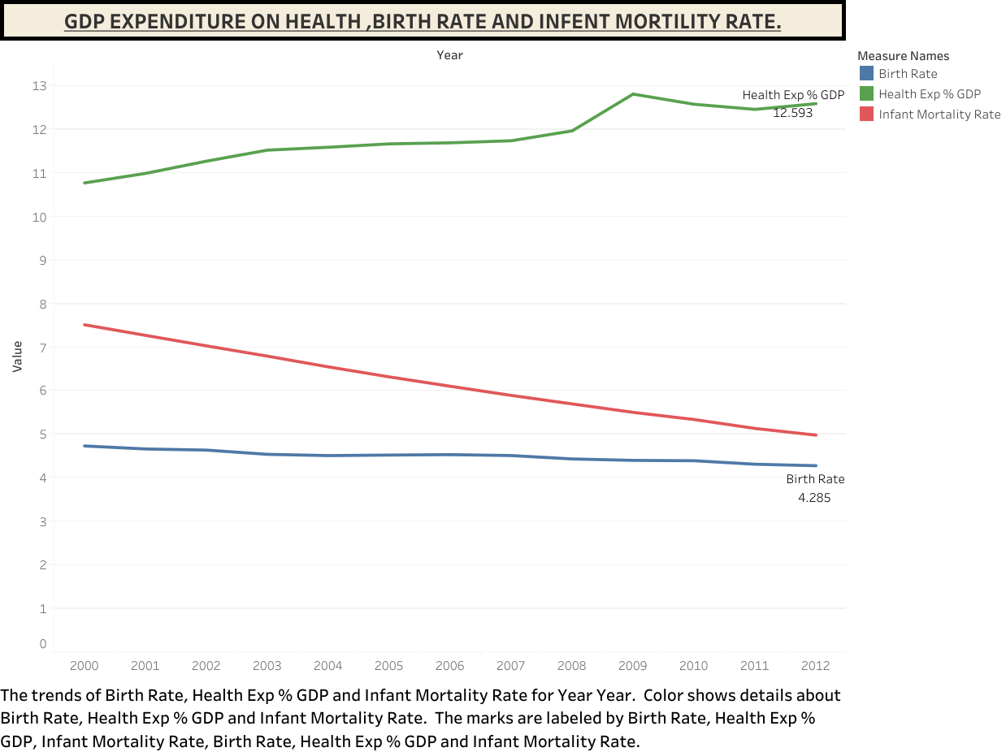

Slide 8
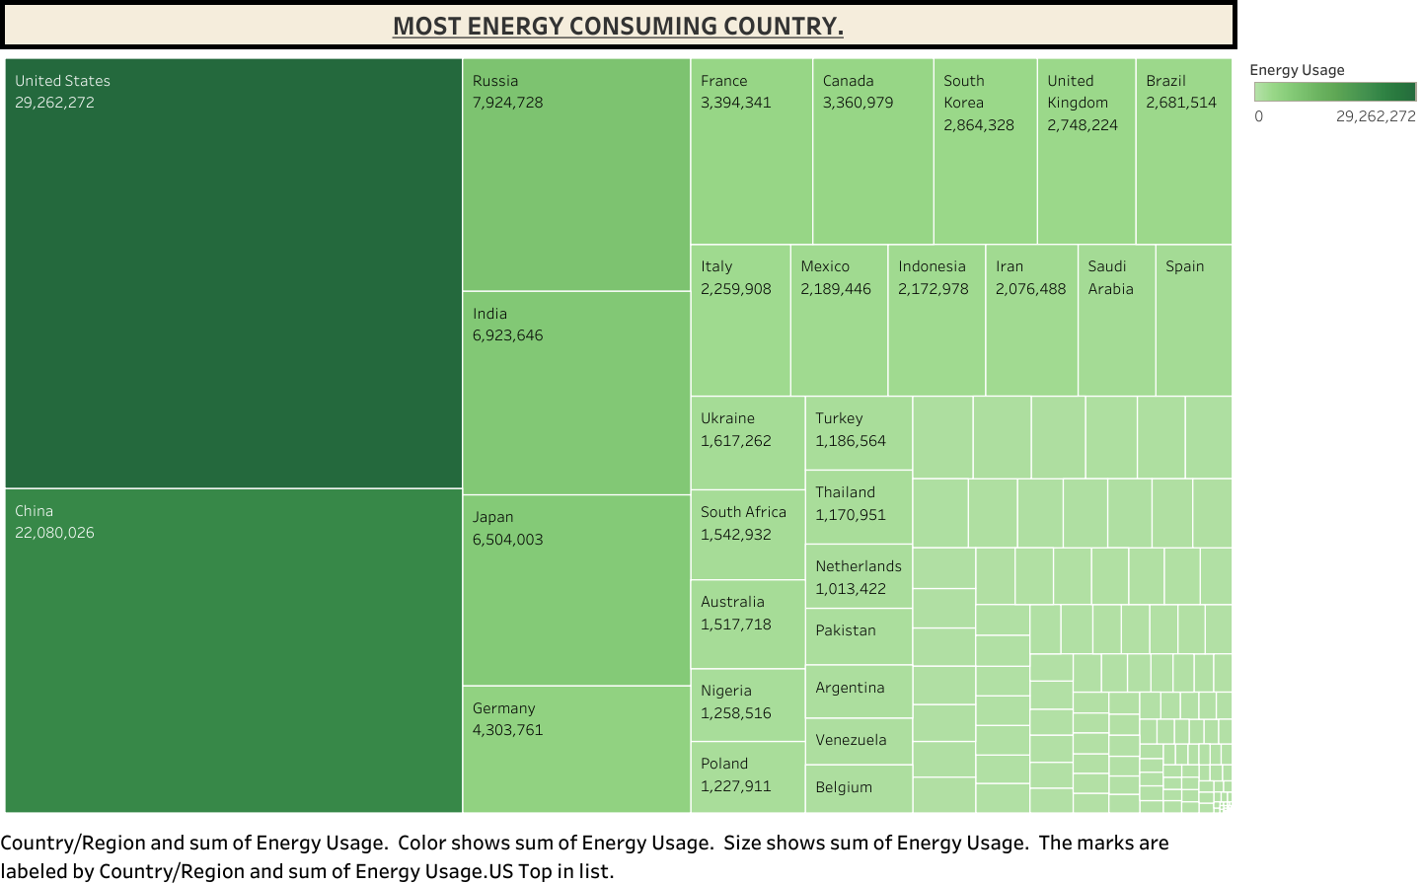

Slide 9
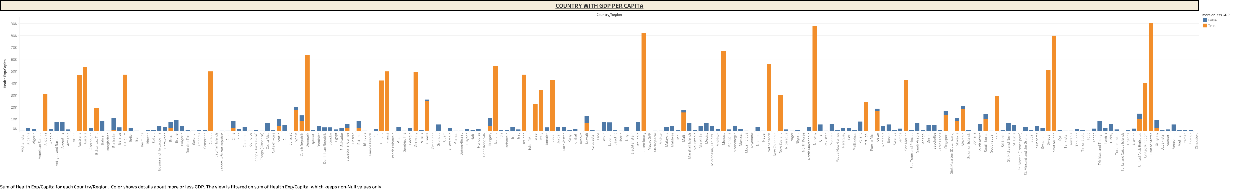

Slide 10
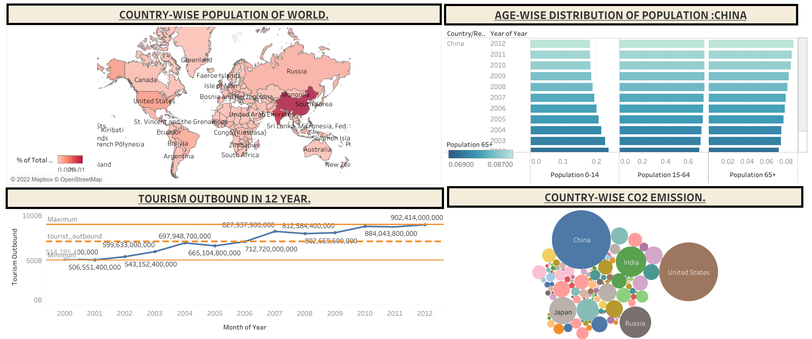

Slide 11
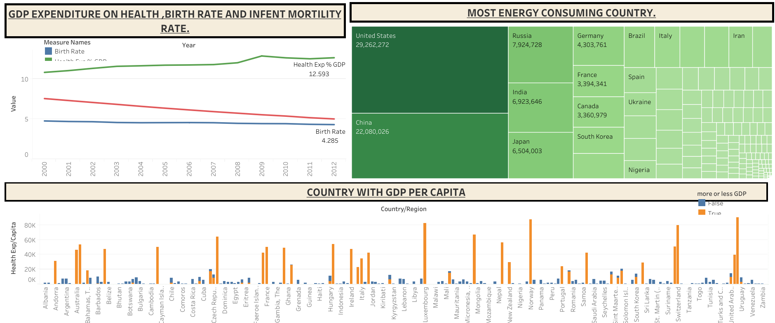

Slide 12
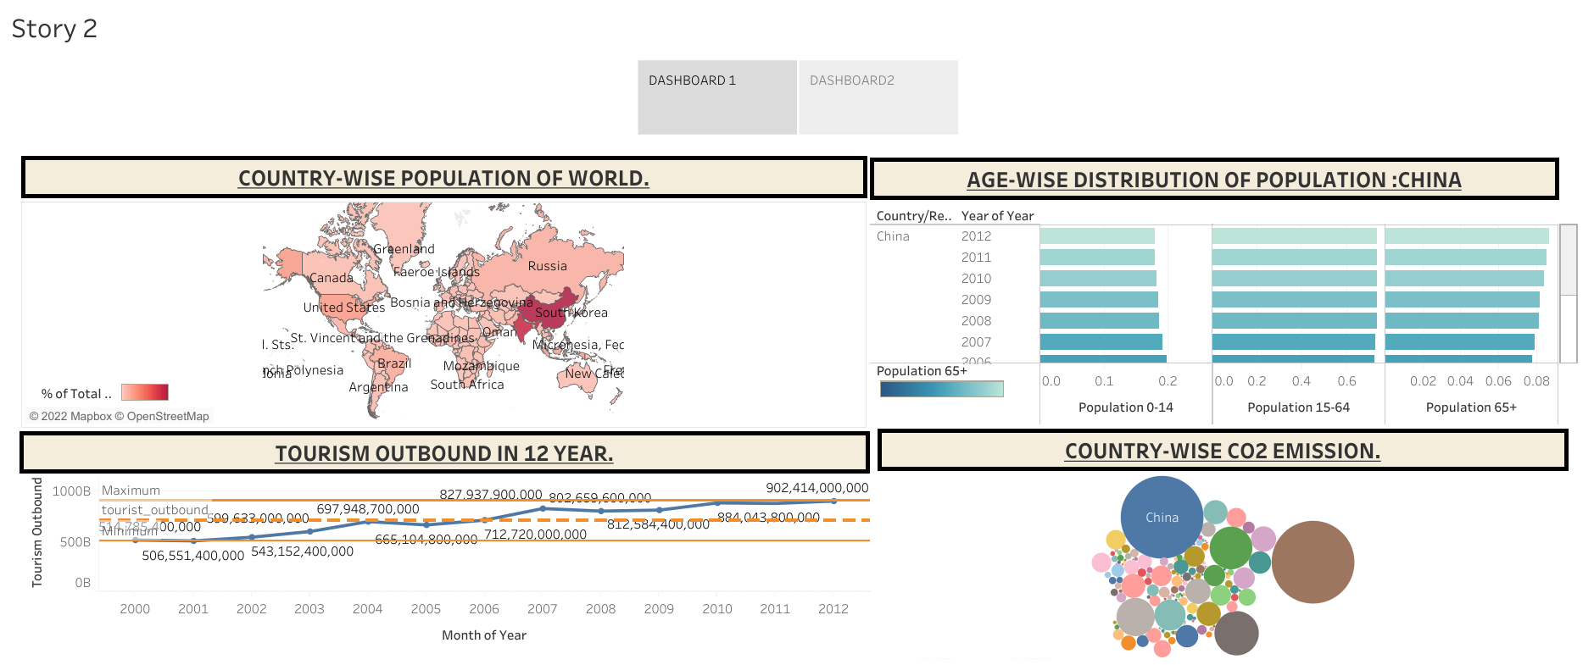

Slide 13
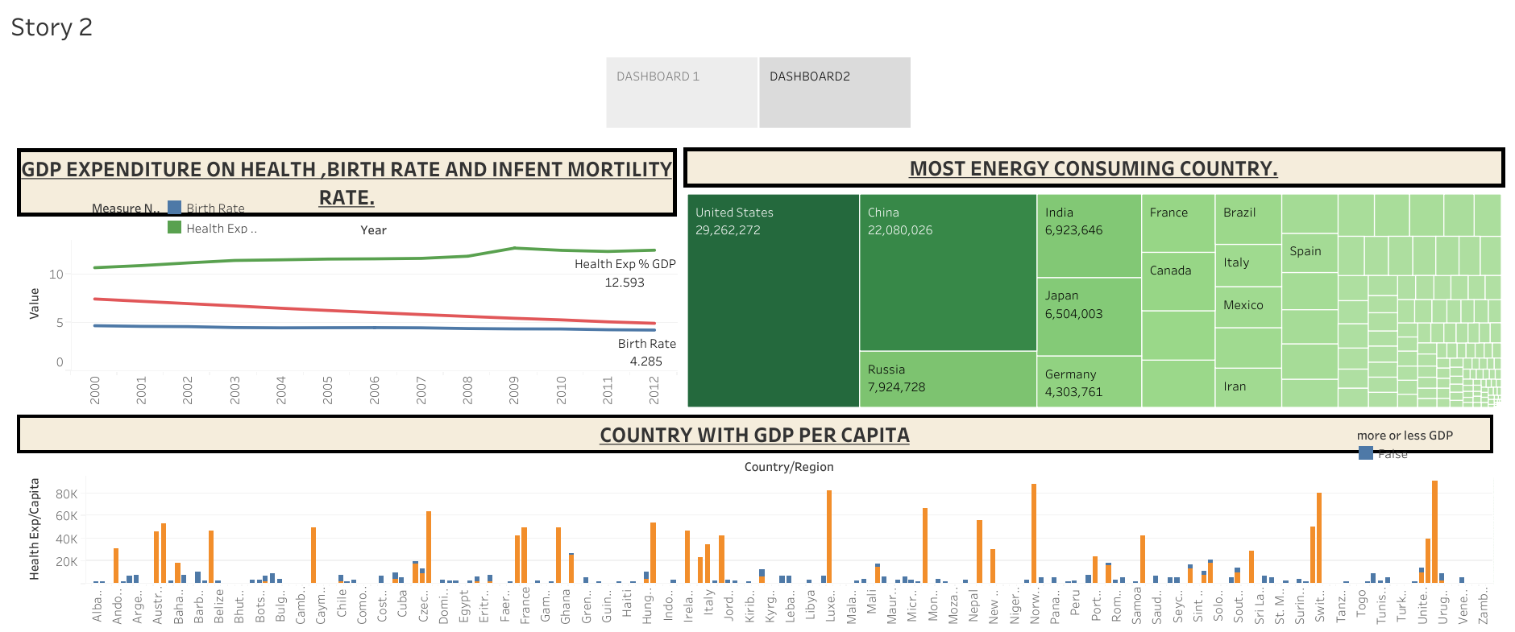

Slide 14
SUMMARY
In data of indicators most populated country is china after india in the world
In china in the age group of 0-14 population is decreasing in trend , where in 15-65 it is constant and in above 65 it is increasing.
Most Co2 emission country in the world china after US.
Most energy consuming country is united state after china.
USA top the list on GDP expenditure per capita.

Slide 15
links
https://drive.google.com/file/d/1aXctLmEhoYYl2kQ4PduAIZ5g85V8P0Y3/view?usp=sharing

